Slide 1
Batteryless Hydrometer
Lightning Talk #2
Project Plan
Group Members: Tilden Chen, Josh Hall, Jensen Mayes, Chris McGrory, Griffin Orr, Chris Pedersen
Client: Henry Duwe

Slide 2
Key Project Goals
Our Project Goals include the following:
Develop a hydrometer that is:
Batteryless
Fully Encapsulated
Wirelessly transmits data
Long lasting
Learn about team collaboration on large projects and project management skills.
Develop knowledge on PCB design and assembly.
Develop knowledge on mechanical design and physical integration of electrical subsystems into mechanical housings.

Slide 3
System Block Diagram

Slide 4
Conceptual Sketch

Slide 5
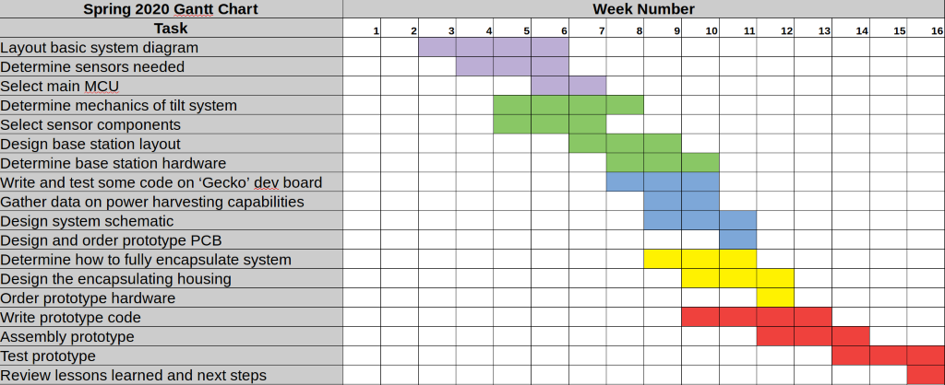
Spring 2020 Timeline
Our Spring 2020 Timetable has been set out in the following Gantt Chart:

Slide 6
Fall 2020 Timeline
Our preliminary Fall 2020 timeline is as follows:
August
Review previous semesters work and determine specific areas to work on.
September
Refine mechanical design and prepare for a fully encapsulated module.
Adjust weighting to increase tilt sensitivity.
Change antenna positioning to improve power harvesting yield.
October
Manufacture the final design prototype.
November
Test the final prototype.
December
Make final adjustments and present our results.

