Slide 1
Batteryless Hydrometer
Lightning Talk #1
Requirements and Standards
Group Members: Tilden Chen, Josh Hall, Jensen Mayes, Chris McGrory, Griffin Orr, Chris Pedersen
Client: Henry Duwe

Slide 2
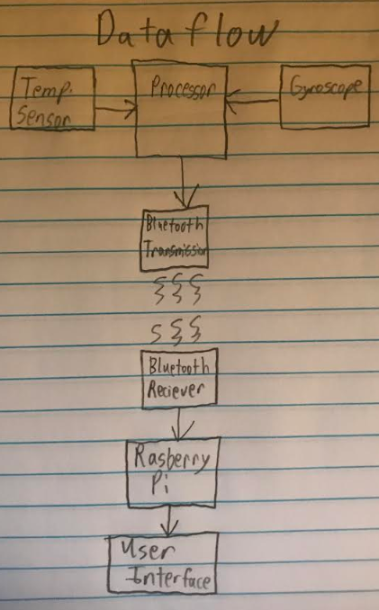
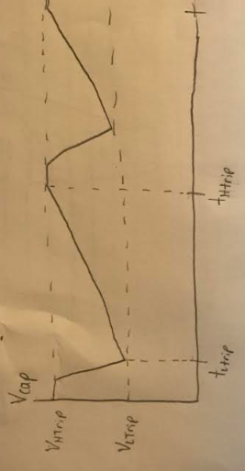
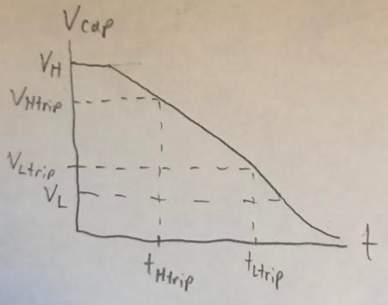
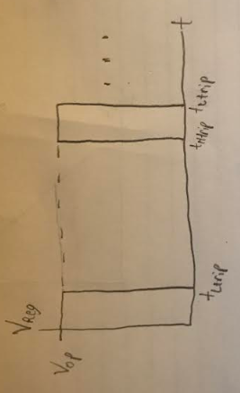
Functional Requirements
1. Dataflow:
- Onboard data processing.
- Wireless data transmission.
- Data Repository.
- User Interface
2. Power Functionality:
- No onboard battery
- Tripping Regulator based
on charge of Supercapacitor
1:
2:
4:
3:

Slide 3
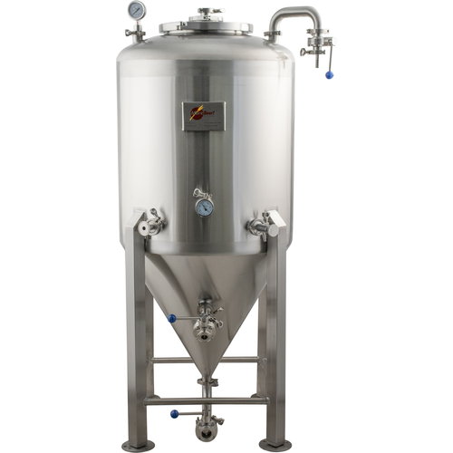
Environmental Requirements
1. Wireless Power Transmission:
- 915 MHz power signal.
- Signal dissipation/limitations.
- Signal reception length: 2-ft maximum.
- Strong/consistent enough to power onboard electronics.
2. Data Communication:
- Bluetooth 5.0: 40–400 m (100–1,000 ft).
3. Mechanical Design:
- Consistent float/buoyancy.
- Completely encapsulated.
- Smooth design to eliminate bacteria growth.
- Temperature resistant design.

Slide 4
Economic Requirements
1. Current Market Offerings:
- $140 'Tilt' Brand Hydrometer
- Bluetooth with a Rechargeable Battery
- Floats inside the fermentation tank
- $400 'EasyDens' Hydrometer
- Bluetooth with a Rechargeable Battery
- Sits outside tank, manually get samples
2. Prototyping Limitations:
- Need to stay within the senior design budget
- Need to focus on low cost prototype boards
- Need to utilize the wireless power development boards available from our customer
3. Final Design Objectives:
- Sub $150 retail price estimate
- Design it for easy manufacturability
Notes:
Jensen is taking care of this slide

Slide 5
Relevant Engineering Standards
Hardware selection should be documented with reasoning
(e.g. microcontrollers, gyroscopes, etc should have different pros and cons listed)
Final hydrometer should use a custom PCB
Streamlined and robust solution for distribution
Software should be concise
Changes should be tracked and commented
Prioritize client satisfaction
Regular meetings with the client to ensure clear communication

Slide 6
Wireless Communication Requirements
Connectionless Bluetooth 5 data transfer
Bluetooth Beacon
2.4 GHz
Low power operation
Limited power available
Short time-frame to transmit
Sensor data
Temperature
Specific gravity
Computation done on-device

