Slide 1
Batteryless Hydrometer
Final Project Review
Group Members: Tilden Chen, Josh Hall, Jensen Mayes, Chris McGrory, Griffin Orr, Chris Pedersen
Client: Henry Duwe

Slide 2
Project Requirements
Battery less/wirelessly powered
Temperature sensor: accuracy of 1 degree Celsius
Specific Gravity: accuracy of +/- 0.001
Wireless transmission
Encapsulated
Notes:
Hello I’m Christopher Pedersen.
The first topic I am talking about is the project requirements given to us by the client:
The battery less hydrometer must be wirelessly powered, and the circuit cannot have a battery.
The hydrometer must have a temperature sensor with an accuracy of 1 degree Celsius and a method of sensing specific gravity with an accuracy of +/- 0.001
The hydrometer must wirelessly transmit readings with a minimum frequency of hourly.
Finally, the hydrometer must be completely encapsulated.

Slide 3
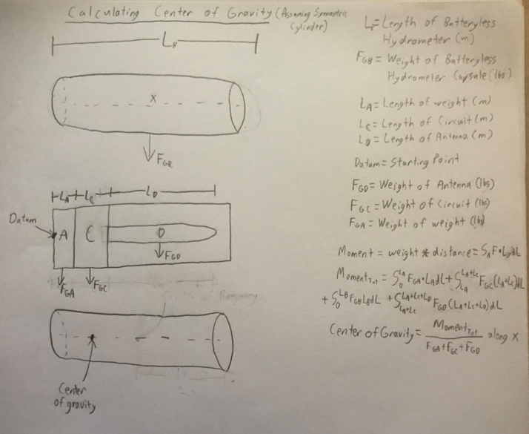
Implementation Specifications
Energy Harvesting
Sensors
Wireless Transmission
Encapsulated
Notes:
This slide is dedicated to the discussion of the implementation specifications of the batteryless hydrometer based on the client’s requirements:
The energy harvesting circuit will operate at a frequency of 915 MHz and be capable of energy harvesting from 2 feet away. The energy harvesting receiver we selected has an input power frequency of 915 MHz and converts RFin to DC then stores power in a capacitor. This will be discussed further in the hardware development section of this presentation.
The temperature sensor we selected is accurate to +/- 0.4 degrees Celsius.
According to Archimedes principle the buoyant force on a floating body is equal to the magnitude of the weight of the floating body. In other words, the object sinks into the liquid until the weight of the liquid it displaces is equal to its own weight. Our encapsulated hydrometer takes advantage of this change in submerged volume by detecting changes in tilt. It is this tilting that we will use to calculate the specific gravity of the fluid. In order to detect the tilt, we will use an accelerometer. The IMU we selected has a 3-axis gyroscope and a 3-axis accelerometer. We will be using the accelerometer to calculate the specific gravity of the liquid by detecting changes in the capsule’s submersion in the liquid.
The wireless transmission module we selected is a Bluetooth 5 Microcontroller from Silicon Labs that operates at 2.4 GHz. It is difficult to say at this time how often our circuit will be able to transmit data back to the base station because we have not had the opportunity to do much power analysis however we carefully selected chips with low power consumption.
Our capsule will be fully encapsulated and liquid proof.

Slide 4
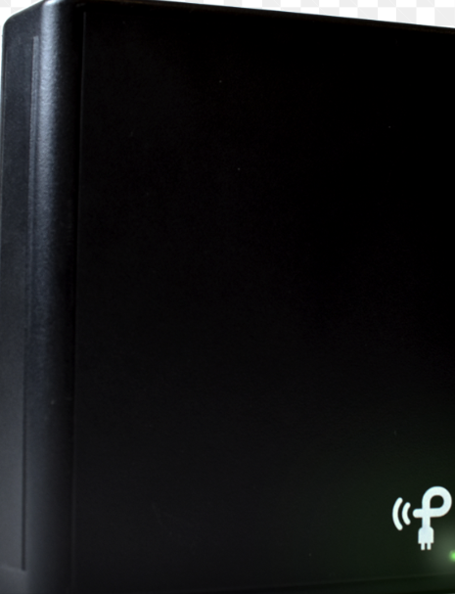
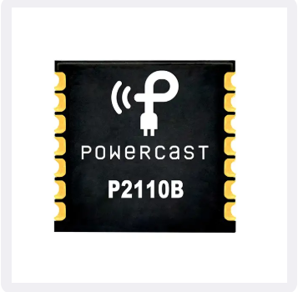
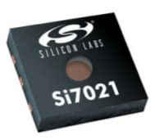
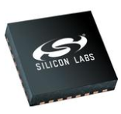
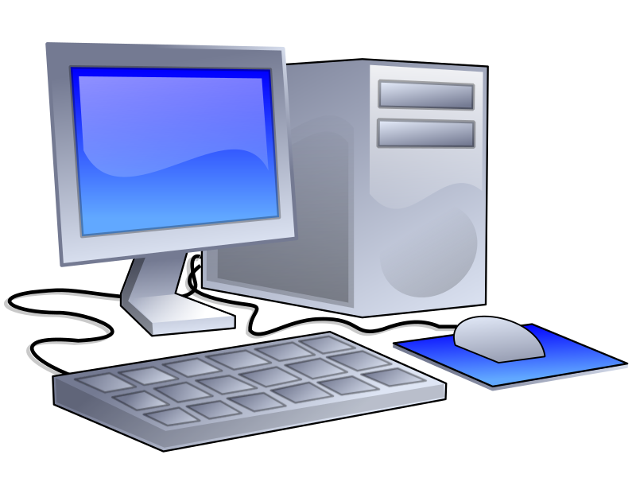
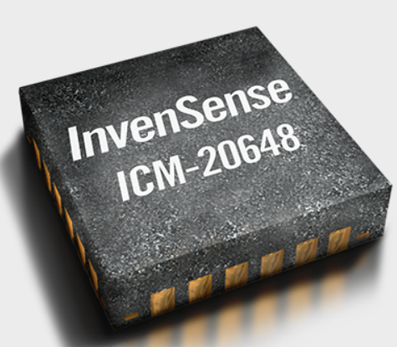
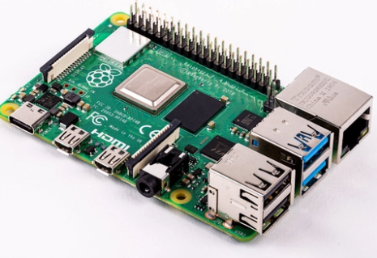
System Level Overview
915 MHz
Capacitor
Power Storage
2.4 GHz
I2C
I2C/SPI
Notes:
This slide is dedicated to a system level overview of the battery less hydrometer:
The system starts with an external source of a 915 MHz radio frequency generator. The wireless energy harvesting circuit then collects power from the 915 MHz signal and stores it in the capacitors.
The sensors then make their readings and communicate them to the microcontroller and when the capacitors have enough charge the data is transmitted over Bluetooth to the Raspberry Pi base station. The base station will receive the signals from the capsule and provide a user interface in the form of a small web-server.

Slide 5
Tilt Mechanics
Based off Hydromechanical Principals
System works in the following method:
When at equilibrium the Center of Gravity (CoG) and Center of Bouyancy (CoB) are in the same vertical line
As the specific gravity increases it moves the CoB which causes the device to tilt until it has reached equilibrium
This is continuous as the the specific gravity both increases and decreases
Notes:
Hello my name is Jensen Mayes and I'll be talking about the tilt mechanics of our hydrometer. tOne of the most important parts of our project is a properly working tilt hydrometry system. It seemed quite complicated at first but after learning some more about hydromechanics I learned that it works off of a relatively simple set of rules. Essentially the concept works by the fact that the Center of Gravity and Center of Bouyancy always want to be in the same vertical line to be in equilibrium. For this to happen the system will tilt in order to keep them in alignment. As the specific gravity increases, it causes the Center of Bouyancy to move downwards to the new geometric center as the system begins floating slightly higher in the water. Since the Center of Bouyance is offset from the center of mass this will create a torque on the system which will make it tilt in order to realign the Center of Bouyancy with the Center of Mass. This same relationship works in reverse with an increase in specific gravity causing an increase in tilt and vice versa. As you can see this system is simple and reliable which leads to it being an effective way to implement a hydrometer.

Slide 6
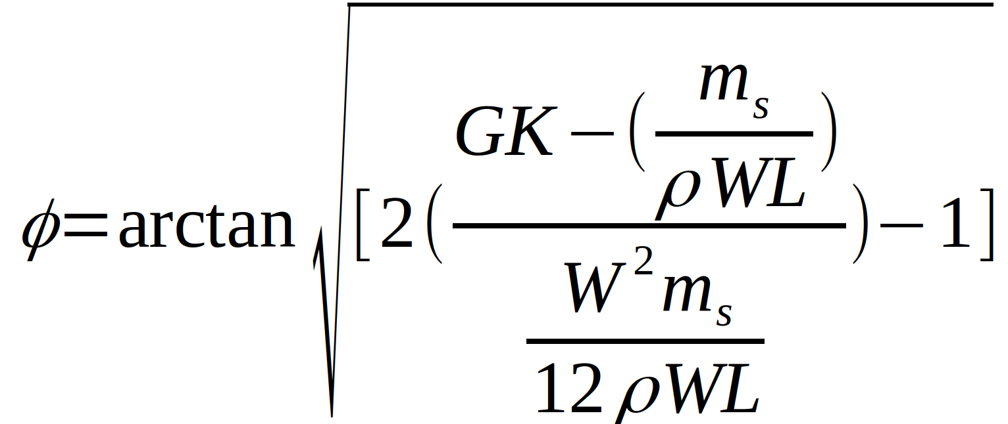
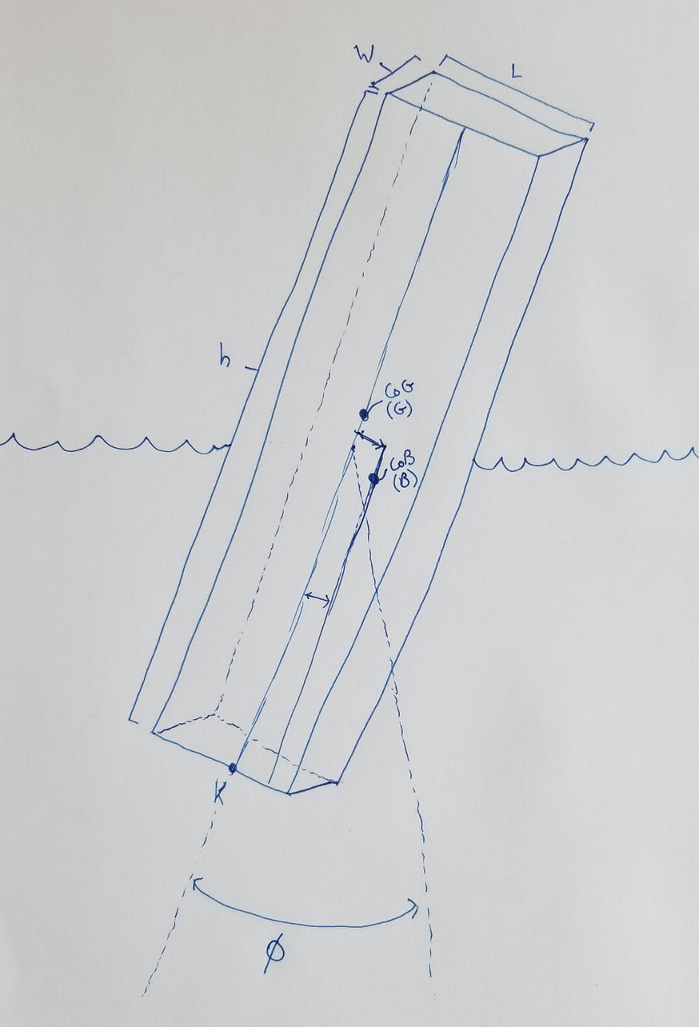
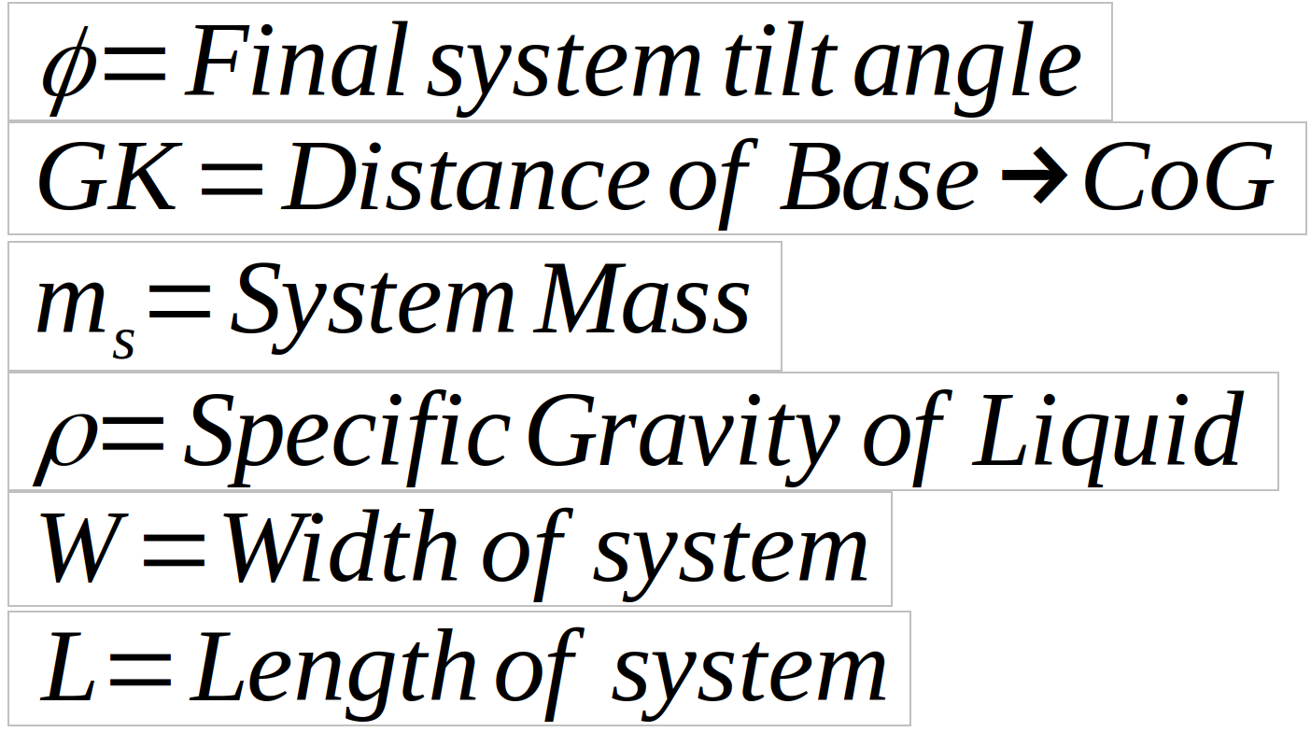
Tilt Mechanics
From a purely mathematical standpoint, for a simplified rectangular prism model, the following equation represents the tilting action:
* As you can see this relationship will be nonlinear
Notes:
Going a step past the concept of the tilt mechanism I was able to find a book on offshore hydromechanics from Delft University that talked about static floating stability as well as some online forums where I was able to solve for the equation shown above as a representation of the tilt action based off of the given variables. In operation only one variable of this equation will change which is the specific gravity of the liquid, the rest will act as constants leading to a change in the angle of tilt. Also, by looking at this equation we know that the relationship will be nonlinear at least for large windows of operation. I will need to do more testing to find out if our window of operation is small enough to treat the system as linear which may simplify the calculations for the system or if we will need to account for the nonlinearity in our static calculations. Additionally, by solving this equation for rho we can use the tilt that is measured to find the specific gravity which is likely the way in which we will calculate the specific gravity of the liquid in our actual implementation.

Slide 7
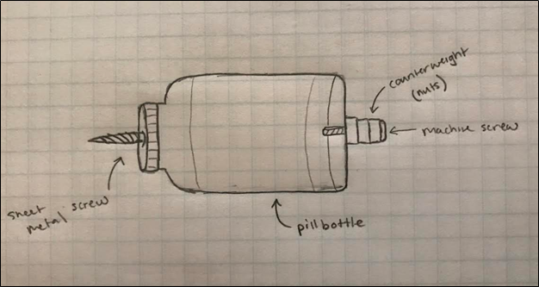
Mechanical Encapsulation - Testing
Procedure:
Fix protractor scale to the longer side of the Tupperware container.
Add 10 cups of tap water to Tupperware container.
Place modified pill bottle in filled Tupperware container.
Add ¼ cup of sugar.
Record degree of tilt and volume of sugar.
Repeat steps 4 & 5 until reaching 5 cups of sugar.
Notes:
Hello, my name is Chris McGrory, and I will be talking about the mechanical encapsulation of the batteryless hydrometer.
To ensure that our encapsulation prototype would represent the physics of a tilt hydrometer we first had to create a proper testing environment.
In this environment we constructed a tilt mechanism out of household materials that proportional aligns with the physical elements of our encapsulation prototype.
We then set the tilt mechanism a float within a Tupperware container filled with 10 cups of tap water and recorded the baseline tilt.
Next, we added ¼ cup of sugar until we reached 5 cups (½ the volume of the baseline water).
Each time we added a ¼ cup of sugar the degree of tilt was recorded.

Slide 8
Mechanical Encapsulation - Results Overview
Notes:
In our experiment we found that there was a linear relationship between the degree of tilt and specific gravity of a fluid.
As we increased the specific gravity of water by adding sugar to the system the tilt mechanism displayed a greater degree of tilt.
Another relationship that we discovered was the effects of the counterweight on the degree of tilt.
As we increased the counterweight the increment of tilt decreased.
Overall, this experiment proved that our prototype would provide us with a linear relationship between specific gravity and axis degree tilt. It also gave us greater insight to what design flexibilities we have as we continue prototyping.

Slide 9
Mechanical Encapsulation – Design Overview
Main Design Attributes:
Divided into two plastic threaded pieces (Easter egg).
The top piece will be 2/3 the volume of the entire encapsulation.
Each piece will be modeled in SolidWorks and 3D printed.
A counterweight is located at the bottom of the encapsulation to influence the degree of tilt.
Once testing is complete the encapsulation will be completely sealed in a temperature resistant epoxy.
Notes:
The encapsulation is divided into two threaded pieces.
This two-piece design allows the device internals to be accessible during prototyping.
The top half should be roughly 2/3 the overall length of the encapsulation.
The bottom half is fitted with an appropriate amount of filled weight so that the encapsulation will partially submerge itself into the fluid. The volume of this component has not been determined but we can adjust it so that it does not interfere with our degree of tilt and appropriate buoyancy.
Each Piece will be modeled in SolidWorks and 3D printed.
Once prototyping is complete the encapsulation will be completely sealed using a temperature resistant epoxy.

Slide 10
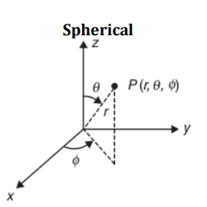
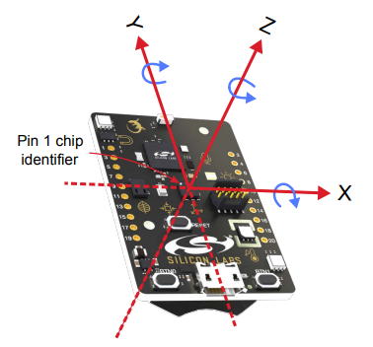
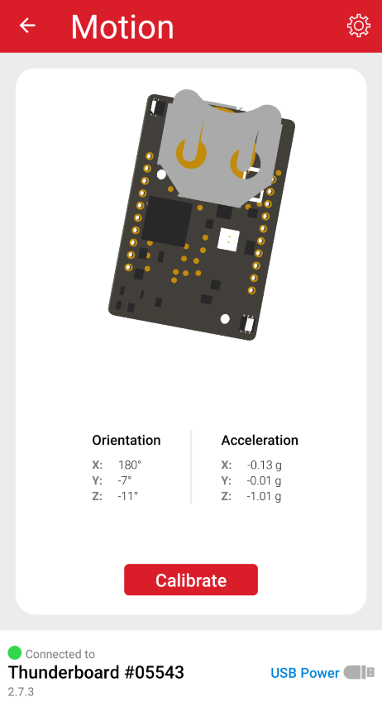
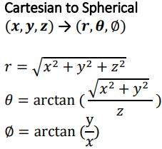
Orientation Detection
Calculations done on board
Accelerometer outputs cartesian vectors
Convert to spherical
$θ$ is the angle relative to gravity vector
Notes:
Hello, my name is Tilden Chen and I’ll be talking about determining hydrometer orientation and communicating this information to the base station. To start, the inertial measurement unit on the Thunderboard Sense 2 is a 6-axis sensor consisting of a 3-axis gyroscope and 3-axis accelerometer. This is illustrated in the top right image, the accelerometer in red and the gyroscope in blue. We are only interested in accelerometer’s output, which outputs a unit vector in cartesian coordinates representing the forces in three directions acting on the sensor. I’ve added a screenshot from the Thunderboard app to better illustrate this, look at the picture captioned “Motion”, in the bottom left, and the “x”, “y”, and “z” outputs under “Acceleration”.
The logic that needs to be implemented here is pretty simple. Because the hydrometer’s tilt is linearly proportional to the specific gravity of the liquid it is in, we are interested in the angle between our hydrometer and the gravity vector. We can find this angle by converting the cartesian vector into spherical coordinates and then the $θ$ value will be the angle between our hydrometer and the gravity vector.
From here, we can calibrate the specific gravity output by plotting the angle at different specific gravities and then create a linear function from this. If for whatever reason the relationship between the tilt and specific gravity is NOT proportional, we can just plot the angles and specific gravities in Excel and using that to generate a best-fit polynomial equation.
The only problem I see right now is that the calculations would be wonky if they were done during motion, such as when the hydrometer is changing orientation. In the original context of the hydrometer operating in a closed environment where the specific gravity change is very gradual, I don’t think this will be an issue, but I add some type of debouncing logic to alleviate this.

Slide 11
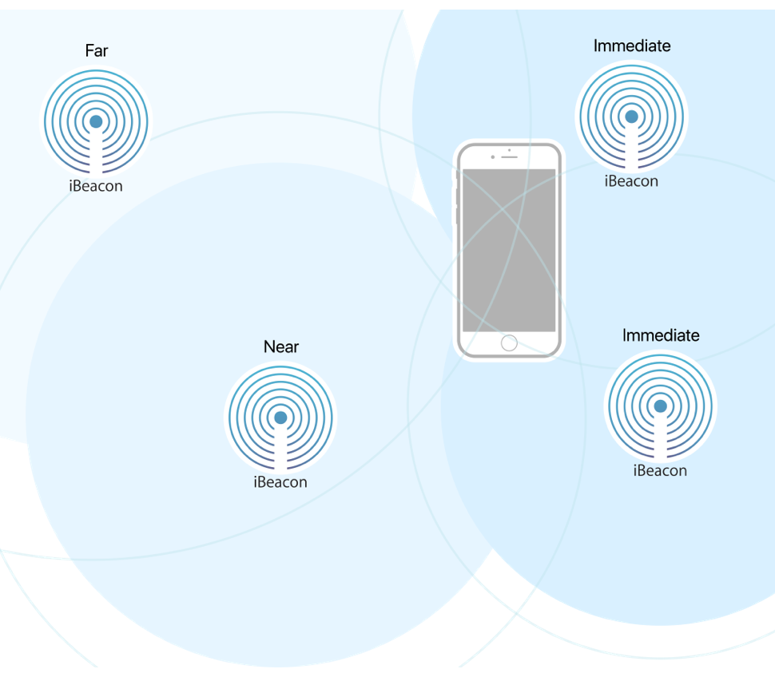
Orientation communication
Notes:
Regarding communication, we will send the orientation information through Bluetooth beacon. The hydrometer will be periodically transmitting orientation information, calculated on the board, and then the base station, like the phone in the picture, will always be listening. We want to transmit once every hour or so. I’m not very familiar with communications but my understanding is that beacon follows the structure in the top image, and we should be able to encode the orientation information in the data payload through the Thunderboard’s Bluetooth modules and then decrypt it on our base station. A long-term goal would be to then upload that information to a website that continuously updates with current information that can easily be viewed from different devices.

Slide 12
Software Overview
Raspberry Pi will be used as the base station
Constantly scan for ibeacon transmissions
Host a web server for the user to be able to access ibeacon data
MCU
Gather sensor data and perform calculations to get the specific gravity
Send a Bluetooth beacon with the specific gravity data

Slide 13
Hardware Selection
Microcontroller
Silicon Labs EFR32BG13
Bluetooth 5
Inertial Sensing
TDK InvenSense ICM-20648
6-axis MEMS device
3-axis gyroscope
3-axis accelerometer
Temperature Sensing
Texas Instruments LM75
Digital temperature sensor
Notes:
Hello, my name is Griffin Orr and I will be covering the hardware in our design. Our device will be fully capable of performing on-device computation and wireless transmission of gathered sensor data. To achieve this, the EFR32BG13 microcontroller from Silicon Labs was selected. This device has fast wake-up times, low power consumption, and an on-chip 2.4 GHz receiver with a Bluetooth 5 PHY. To obtain our orientation for tilt calculations, the ICM-20648 6-axis MEMS device was selected. This device has a 3-axis gyroscope and a 3-axis accelerometer and is capable of digital communication via SPI. To collect the temperature of the air, an LM75 digital temperature sensor will be used.

Slide 14
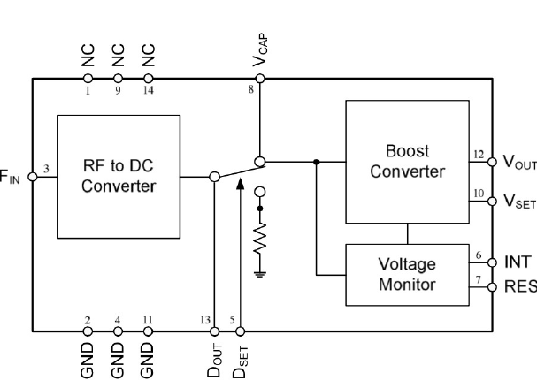
Energy Harvesting Hardware
915 MHz RF PowerHarvester Receiver Module P2110B
Monitor and controls harvested energy
Supplies main power
Notes:
One of our major design constraints for this project is the requirement to be powered from harvested energy and not a battery. To this end, we will be using a module developed by the same company that created the energy harvesting transmitter and antenna to control the on-device power. This module has a 50 ohm impedance matched connection to receive the power from the antenna, a configurable and regulated voltage output for the main board power supply, and an output to a capacitor, which will serve as an energy storage device to power the microcontroller during the data collection and transmission phase.

Slide 15
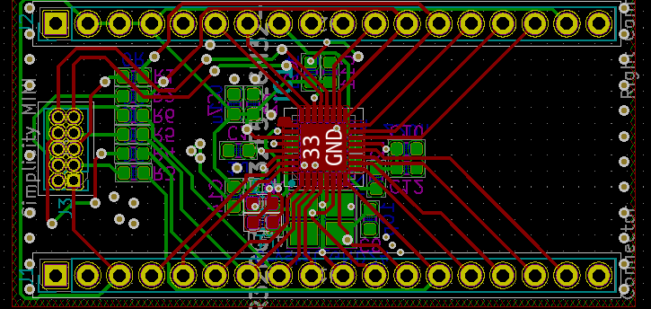
Hardware Development
Development breakout board designed
Allows access to all microcontroller pins
Provides power circuitry for the microcontroller
Microcontroller programming port
Preliminary impedance matching network for antenna
Notes:
Though we have had very little lab access through much of this semester, we were able to design a prototype board that will allow us to program and prototype with our microcontroller. This board breaks out all of the pins of the microcontroller to pins that will allow the board to be utilized in a breadboard. The board also has all of the power circuitry for the microcontroller, as well as the crystal oscillator. Additionally, the board features a programming port that will allow for easy programming of the microcontroller while connected to the breadboard. Another portion of the hardware design process is the impedance matching network. At this point, we have a preliminary design for this network, but will not have a final design until lab access returns and it can be tested with a network analyzer.

Slide 16
Future Plans
Summer 2020
Write Base Station software and web interface.
Make some more progress on the software for use on the module itself.
Fall 2020
Build an initial prototype early in the fall.
Complete significant amounts of testing.
Design and manufacture a final, more streamlined prototype in November.
Have the system completed to present in early December.
Notes:
For this summer and next fall we plan to complete the remainder of our project. Due to some of the challenges with this spring we are planning to work on some of the software side of our project this summer by writing a significant portion of the base station receiving software and the web interface for users. We also hope that over the summer we'll be able to make some progress on the software for the module so that we are in a good position to hit the ground running in the fall. Once the fall arrives we hope to quickly get a prototype built so that we can test it thoroughly and have data to work with for designing a final revision which we hope to have created by mid to late November so that we can complete some more testing and finalize the system in early December for the final presentation.

Slide 17
Please Email with any questions, thank you.
Notes:
Please email us with any questions and thank you for listening to our presentation.

